Slide 1
Chapter 20 – Java Utilities Package and Bit Manipulation
Outline
20.1 Introduction
20.2 Vector Class and Enumeration Interface
20.3 Stack Class
20.4 Dictionary Class
20.5 Hashtable Class
20.6 Properties Class
20.7 Random Class
20.8 Bit Manipulation and the Bitwise Operators
20.9 BitSet Class

Slide 2
20.1 Introduction
Utility classes and interfaces
  Contained in package java.util
    Class Vector
    Interface Enumeration
    Class Stack
    Class Dictionary
    Class Hashtable
    Class Properties
    Class Random
    Class BitSet

Slide 3
20.2 Vector Class and Enumeration Interface
Class java.util.Vector
  Array-like data structure that can resize itself dynamically
  Contains a capacity
  Grows by capacity increment if it requires additional space

Slide 4
Fig. 20.1 Demonstrating class Vector of package java.util.
Line 26
1 // Fig. 20.1: VectorTest.java
2 // Testing the Vector class of the java.util package
3
4 // Java core packages
5 import java.util.*;
6 import java.awt.*;
7 import java.awt.event.*;
8
9 // Java extension packages
10 import javax.swing.*;
11
12 public class VectorTest extends JFrame {
13 private JLabel statusLabel;
14 private Vector vector;
15 private JTextField inputField;
16
17 // set up GUI to test Vector methods
18 public VectorTest()
19 {
20 super( "Vector Example" );
21
22 Container container = getContentPane();
23 container.setLayout( new FlowLayout() );
24
25 statusLabel = new JLabel();
26 vector = new Vector( 1 );
27
28 container.add( new JLabel( "Enter a string" ) );
29
30 inputField = new JTextField( 10 );
31 container.add( inputField );
32
33 // button to add element to vector
34 JButton addButton = new JButton( "Add" );
35
Create Vector with initial capacity of one element

Slide 5
Fig. 20.1 Demonstrating class Vector of package java.util (Part 2).
Line 43
Lines 63-65
36 addButton.addActionListener(
37
38 new ActionListener() {
39
40 public void actionPerformed( ActionEvent event )
41 {
42 // add an element to vector
43 vector.addElement( inputField.getText() );
44 statusLabel.setText( "Added to end: " +
45 inputField.getText() );
46 inputField.setText( "" );
47 }
48 }
49 ); // end call to addActionListener
50
51 container.add( addButton );
52
53 // button to remove element from vector
54 JButton removeButton = new JButton( "Remove" );
55
56 removeButton.addActionListener(
57
58 new ActionListener() {
59
60 public void actionPerformed( ActionEvent event )
61 {
62 // remove element from vector
63 if ( vector.removeElement( inputField.getText() ) )
64 statusLabel.setText( "Removed: " +
65 inputField.getText() );
66 else
67 statusLabel.setText( inputField.getText() +
68 " not in vector" );
69 }
70 }
Vector method addElement appends Object to Vector
Vector method removeElement removes Object from Vector

Slide 6
Fig. 20.1 Demonstrating class Vector of package java.util (Part 3).
Line 87
71 ); // end call to addActionListener
72
73 container.add( removeButton );
74
75 // button to get first element of vector
76 JButton firstButton = new JButton( "First" );
77
78 firstButton.addActionListener(
79
80 new ActionListener() {
81
82 public void actionPerformed( ActionEvent event )
83 {
84 // return first element of vector
85 try {
86 statusLabel.setText(
87 "First element: " + vector.firstElement() );
88 }
89
90 // catch exception if Vector empty
91 catch ( NoSuchElementException exception ) {
92 statusLabel.setText( exception.toString() );
93 }
94 }
95 }
96 ); // end call to addActionListener
97
98 container.add( firstButton );
99
100 // button to get last element of vector
101 JButton lastButton = new JButton( "Last" );
102
103 lastButton.addActionListener(
104
Vector method firstElement obtains first Object in Vector

Slide 7
Fig. 20.1 Demonstrating class Vector of package java.util (Part 4).
Line 112
Line 135
105 new ActionListener() {
106
107 public void actionPerformed( ActionEvent event )
108 {
109 // return last element of vector
110 try {
111 statusLabel.setText(
112 "Last element: " + vector.lastElement() );
113 }
114
115 // catch exception if Vector empty
116 catch ( NoSuchElementException exception ) {
117 statusLabel.setText( exception.toString() );
118 }
119 }
120 }
121 ); // end call to addActionListener
122
123 container.add( lastButton );
124
125 // button to determine whether vector is empty
126 JButton emptyButton = new JButton( "Is Empty?" );
127
128 emptyButton.addActionListener(
129
130 new ActionListener() {
131
132 public void actionPerformed( ActionEvent event )
133 {
134 // determine if Vector is empty
135 statusLabel.setText( vector.isEmpty() ?
136 "Vector is empty" : "Vector is not empty" );
137 }
138 }
139 ); // end call to addActionListener
Vector method lastElement obtains last Object in Vector
Vector method isEmpty returns boolean that indicates whether Vector contains any Objects

Slide 8
Fig. 20.1 Demonstrating class Vector of package java.util (Part 5).
Line 155
140
141 container.add( emptyButton );
142
143 // button to determine whether vector contains search key
144 JButton containsButton = new JButton( "Contains" );
145
146 containsButton.addActionListener(
147
148 new ActionListener() {
149
150 public void actionPerformed( ActionEvent event )
151 {
152 String searchKey = inputField.getText();
153
154 // determine if Vector contains searchKey
155 if ( vector.contains( searchKey ) )
156 statusLabel.setText(
157 "Vector contains " + searchKey );
158 else
159 statusLabel.setText(
160 "Vector does not contain " + searchKey );
161 }
162 }
163 ); // end call to addActionListener
164
165 container.add( containsButton );
166
167 // button to determine location of value in vector
168 JButton locationButton = new JButton( "Location" );
169
170 locationButton.addActionListener(
171
172 new ActionListener() {
173
Vector method contains returns boolean that indicates whether Vector contains a specific Object

Slide 9
Fig. 20.1 Demonstrating class Vector of package java.util (Part 6).
Line 178
Line 195
174 public void actionPerformed( ActionEvent event )
175 {
176 // get location of an object in Vector
177 statusLabel.setText( "Element is at location " +
178 vector.indexOf( inputField.getText() ) );
179 }
180 }
181 ); // end call to addActionListener
182
183 container.add( locationButton );
184
185 // button to trim vector size
186 JButton trimButton = new JButton( "Trim" );
187
188 trimButton.addActionListener(
189
190 new ActionListener() {
191
192 public void actionPerformed( ActionEvent event )
193 {
194 // remove unoccupied elements to save memory
195 vector.trimToSize();
196 statusLabel.setText( "Vector trimmed to size" );
197 }
198 }
199 );
200
201 container.add( trimButton );
202
203 // button to display vector size and capacity
204 JButton statsButton = new JButton( "Statistics" );
205
206 statsButton.addActionListener(
207
Vector method indexOf returns index of first location in Vector containing the argument
Vector method trimToSize reduces the Vector capacity to the current number of elements in Vector

Slide 10
Fig. 20.1 Demonstrating class Vector of package java.util (Part 7).
Lines 213-214
Line 231
208 new ActionListener() {
209
210 public void actionPerformed( ActionEvent event )
211 {
212 // get size and capacity of Vector
213 statusLabel.setText( "Size = " + vector.size() +
214 "; capacity = " + vector.capacity() );
215 }
216 }
217 ); // end call to addActionListener
218
219 container.add( statsButton );
220
221 // button to display vector contents
222 JButton displayButton = new JButton( "Display" );
223
224 displayButton.addActionListener(
225
226 new ActionListener() {
227
228 public void actionPerformed( ActionEvent event )
229 {
230 // use Enumeration to output Vector contents
231 Enumeration enum = vector.elements();
232 StringBuffer buf = new StringBuffer();
233
234 while ( enum.hasMoreElements() )
235 buf.append( enum.nextElement() ).append( " " );
236
237 JOptionPane.showMessageDialog( null,
238 buf.toString(), "Display",
239 JOptionPane.PLAIN_MESSAGE );
240 }
241 }
242 ); // end call to addActionListener
Vector methods size and capacity return number of Objects in Vector and Vector capacity, respectively
Vector method elements returns Enumeration for iterating Vector elements

Slide 11
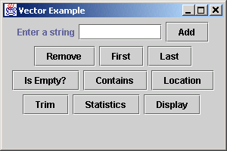
Fig. 20.1 Demonstrating class Vector of package java.util (Part 8).
Program Output
243
244 container.add( displayButton );
245 container.add( statusLabel );
246
247 setSize( 300, 200 );
248 setVisible( true );
249
250 } // end VectorTest constructor
251
252 // execute application
253 public static void main( String args[] )
254 {
255 VectorTest application = new VectorTest();
256
257 application.setDefaultCloseOperation(
258 JFrame.EXIT_ON_CLOSE );
259 }
260
261 } // end class VectorTest

Slide 12
20.3 Stack Class
Stack
  Implements stack data structure
  Extends class Vector
  Stores references to Objects (as does Vector)

Slide 13
Fig. 20.2 Demonstrating class Stack of package java.util.
Line 25
1 // Fig. 20.2: StackTest.java
2 // Testing the Stack class of the java.util package
3
4 // Java core packages
5 import java.awt.*;
6 import java.awt.event.*;
7 import java.util.*;
8
9 // Java extension packages
10 import javax.swing.*;
11
12 public class StackTest extends JFrame {
13 private JLabel statusLabel;
14 private JTextField inputField;
15 private Stack stack;
16
17 // create GUI to manipulate a Stack
18 public StackTest()
19 {
20 super( "Stacks" );
21
22 Container container = getContentPane();
23
24 statusLabel = new JLabel();
25 stack = new Stack();
26
27 container.setLayout( new FlowLayout() );
28 container.add( new JLabel( "Enter a string" ) );
29 inputField = new JTextField( 10 );
30 container.add( inputField );
31
32 // button to place object on stack
33 JButton pushButton = new JButton( "Push" );
34
Create empty Stack

Slide 14
Fig. 20.2 Demonstrating class Stack of package java.util (Part 2).
Line 43
Line 61
35 pushButton.addActionListener(
36
37 new ActionListener() {
38
39 public void actionPerformed( ActionEvent event )
40 {
41 // put object on Stack
42 statusLabel.setText( "Pushed: " +
43 stack.push( inputField.getText() ) );
44 }
45 }
46 );
47
48 container.add( pushButton );
49
50 // button to remove top object on stack
51 JButton popButton = new JButton( "Pop" );
52
53 popButton.addActionListener(
54
55 new ActionListener() {
56
57 public void actionPerformed( ActionEvent event )
58 {
59 // remove element from Stack
60 try {
61 statusLabel.setText( "Popped: " + stack.pop() );
62 }
63
64 // process exception if Stack empty
65 catch ( EmptyStackException exception ) {
66 statusLabel.setText( exception.toString() );
67 }
68 }
69 }
Stack method push adds Object argument to top of Stack
Stack method pop removes Object from top of Stack

Slide 15
Fig. 20.2 Demonstrating class Stack of package java.util (Part 3).
Line 85
70 );
71
72 container.add( popButton );
73
74 // button to look at top element of stack
75 JButton peekButton = new JButton( "Peek" );
76
77 peekButton.addActionListener(
78
79 new ActionListener() {
80
81 public void actionPerformed( ActionEvent event )
82 {
83 // look at top object on Stack
84 try {
85 statusLabel.setText( "Top: " + stack.peek() );
86 }
87
88 // process exception if Stack empty
89 catch ( EmptyStackException exception ) {
90 statusLabel.setText( exception.toString() );
91 }
92 }
93 }
94 );
95
96 container.add( peekButton );
97
98 // button to determine whether stack is empty
99 JButton emptyButton = new JButton( "Is Empty?" );
100
101 emptyButton.addActionListener(
102
103 new ActionListener() {
104
Stack method peek returns Object from top of Stack, without removing that Object

Slide 16
Fig. 20.2 Demonstrating class Stack of package java.util (Part 4).
Line 108
Line 127
105 public void actionPerformed( ActionEvent event )
106 {
107 // determine if Stack is empty
108 statusLabel.setText( stack.empty() ?
109 "Stack is empty" : "Stack is not empty" );
110 }
111 }
112 );
113
114 container.add( emptyButton );
115
116 // button to determine whether search key is in stack
117 JButton searchButton = new JButton( "Search" );
118
119 searchButton.addActionListener(
120
121 new ActionListener() {
122
123 public void actionPerformed( ActionEvent event )
124 {
125 // search Stack for specified object
126 String searchKey = inputField.getText();
127 int result = stack.search( searchKey );
128
129 if ( result == -1 )
130 statusLabel.setText( searchKey + " not found" );
131 else
132 statusLabel.setText( searchKey +
133 " found at element " + result );
134 }
135 }
136 );
137
138 container.add( searchButton );
139
Stack method empty returns boolean that indicates whether Stack contains any Objects
Stack method search returns boolean that indicates whether Stack contains specific Object argument

Slide 17
Fig. 20.2 Demonstrating class Stack of package java.util (Part 5).
Line 150
140 // button to display stack contents
141 JButton displayButton = new JButton( "Display" );
142
143 displayButton.addActionListener(
144
145 new ActionListener() {
146
147 public void actionPerformed( ActionEvent event )
148 {
149 // output Stack contents
150 Enumeration enumeration = stack.elements();
151 StringBuffer buffer = new StringBuffer();
152
153 while ( enumeration.hasMoreElements() )
154 buffer.append(
155 enumeration.nextElement() ).append( " " );
156
157 JOptionPane.showMessageDialog( null,
158 buffer.toString(), "Display",
159 JOptionPane.PLAIN_MESSAGE );
160 }
161 }
162 );
163
164 container.add( displayButton );
165 container.add( statusLabel );
166
167 setSize( 675, 100 );
168 setVisible( true );
169 }
170
Stack extends Vector, so class Stack may use method elements to obtain Enumeration for Stack

Slide 18
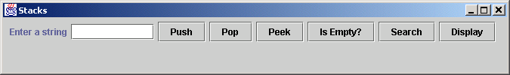
Fig. 20.2 Demonstrating class Stack of package java.util (Part 6).
Program Output
171 // execute application
172 public static void main( String args[] )
173 {
174 StackTest application = new StackTest();
175
176 application.setDefaultCloseOperation(
177 JFrame.EXIT_ON_CLOSE );
178 }
179
180 } // end class StackTest

Slide 19
20.4 Dictionary Class
Dictionary
  Maps keys to values
  Provides public interface
    Methods required to maintain table of key-value pairs
  abstract class
  Superclass of class Hashtable

Slide 20
20.5 Hashtable Class
Hashtable
  Data structure that use hashing
    Algorithm for determining a key in table
      Keys in tables have associated values (data)
  Each table cell is a hash “bucket”
    Linked list of all key-value pairs that hash to that cell
    Minimizes collisions

Slide 21
Fig. 20.3 Demonstrating class Hashtable.
Line 25
1 // Fig. 20.3: HashtableTest.java
2 // Demonstrates class Hashtable of the java.util package.
3
4 // Java core packages
5 import java.awt.*;
6 import java.awt.event.*;
7 import java.util.*;
8
9 // Java extensions packages
10 import javax.swing.*;
11
12 public class HashtableTest extends JFrame {
13 private JLabel statusLabel;
14 private Hashtable table;
15 private JTextArea displayArea;
16 private JTextField lastNameField;
17 private JTextField firstNameField;
18
19 // set up GUI to demonstrate Hashtable features
20 public HashtableTest()
21 {
22 super( "Hashtable Example" );
23
24 statusLabel = new JLabel();
25 table = new Hashtable();
26 displayArea = new JTextArea( 4, 20 );
27 displayArea.setEditable( false );
28
29 JPanel northSubPanel = new JPanel();
30
31 northSubPanel.add( new JLabel( "First name" ) );
32 firstNameField = new JTextField( 8 );
33 northSubPanel.add( firstNameField );
34
Create empty Hashtable

Slide 22
Fig. 20.3 Demonstrating class Hashtable (Part 2).
Lines 59-60
35 northSubPanel.add( new JLabel( "Last name (key)" ) );
36 lastNameField = new JTextField( 8 );
37 northSubPanel.add( lastNameField );
38
39 JPanel northPanel = new JPanel();
40 northPanel.setLayout( new BorderLayout() );
41 northPanel.add( northSubPanel, BorderLayout.NORTH );
42 northPanel.add( statusLabel, BorderLayout.SOUTH );
43
44 JPanel southPanel = new JPanel();
45 southPanel.setLayout( new GridLayout( 2, 5 ) );
46 JButton putButton = new JButton( "Put" );
47
48 putButton.addActionListener(
49
50 new ActionListener() {
51
52 // add new key/value pair to hash table
53 public void actionPerformed( ActionEvent event )
54 {
55 Employee employee = new Employee(
56 firstNameField.getText(),
57 lastNameField.getText() );
58
59 Object value =
60 table.put( lastNameField.getText(), employee );
61
62 // first time this key was added
63 if ( value == null )
64 statusLabel.setText(
65 "Put: " + employee.toString() );
66
Hashtable method put adds key and value to Hashtable (returns null if key has been inserted previously)

Slide 23
Fig. 20.3 Demonstrating class Hashtable (Part 3).
Line 88
67 // replaced previous value for this key
68 else
69 statusLabel.setText(
70 "Put: " + employee.toString() +
71 "; Replaced: " + value.toString() );
72 }
73 }
74 );
75
76 southPanel.add( putButton );
77
78 // button to get value for specific key
79 JButton getButton = new JButton( "Get" );
80
81 getButton.addActionListener(
82
83 new ActionListener() {
84
85 // get value for specific key
86 public void actionPerformed( ActionEvent event )
87 {
88 Object value = table.get( lastNameField.getText() );
89
90 // value found for key
91 if ( value != null )
92 statusLabel.setText(
93 "Get: " + value.toString() );
94
95 // value not found for key
96 else
97 statusLabel.setText(
98 "Get: " + lastNameField.getText() +
99 " not in table" );
100 }
101 }
Hashtable method get obtains Object associated with key from Hashtable (returns null if neither key nor Object exist)

Slide 24
Fig. 20.3 Demonstrating class Hashtable (Part 4).
Lines 116-117
102 );
103
104 southPanel.add( getButton );
105
106 // button to remove key/value pair from table
107 JButton removeButton = new JButton( "Remove" );
108
109 removeButton.addActionListener(
110
111 new ActionListener() {
112
113 // remove key/value pair
114 public void actionPerformed( ActionEvent event )
115 {
116 Object value =
117 table.remove( lastNameField.getText() );
118
119 // key found
120 if ( value != null )
121 statusLabel.setText( "Remove: " +
122 value.toString() );
123
124 // key not found
125 else
126 statusLabel.setText( "Remove: " +
127 lastNameField.getText() + " not in table" );
128 }
129 }
130 );
131
132 southPanel.add( removeButton );
133
134 // button to detetmine whether hash table is empty
135 JButton emptyButton = new JButton( "Empty" );
136
Hashtable method remove removes Object associated with key argument from Hashtable

Slide 25
Fig. 20.3 Demonstrating class Hashtable (Part 5).
Line 144
Lines 161-162
137 emptyButton.addActionListener(
138
139 new ActionListener() {
140
141 // determine whether hash table is empty
142 public void actionPerformed( ActionEvent event )
143 {
144 statusLabel.setText( "Empty: " + table.isEmpty() );
145 }
146 }
147 );
148
149 southPanel.add( emptyButton );
150
151 // button to determine whether hash table contains key
152 JButton containsKeyButton = new JButton( "Contains key" );
153
154 containsKeyButton.addActionListener(
155
156 new ActionListener() {
157
158 // determine whether hash table contains key
159 public void actionPerformed( ActionEvent event )
160 {
161 statusLabel.setText( "Contains key: " +
162 table.containsKey( lastNameField.getText() ) );
163 }
164 }
165 );
166
167 southPanel.add( containsKeyButton );
168
169 // button to clear all hash table contents
170 JButton clearButton = new JButton( "Clear table" );
171
Hashtable method isEmpty returns boolean that indicates whether Hashtable contains any Objects
Hashtable method containsKey returns boolean that indicates whether Hashtable contains key argument

Slide 26
Fig. 20.3 Demonstrating class Hashtable (Part 6).
Line 179
Lines 199-200
172 clearButton.addActionListener(
173
174 new ActionListener() {
175
176 // clear hash table contents
177 public void actionPerformed( ActionEvent event )
178 {
179 table.clear();
180 statusLabel.setText( "Clear: Table is now empty" );
181 }
182 }
183 );
184
185 southPanel.add( clearButton );
186
187 // button to display hash table elements
188 JButton listElementsButton = new JButton( "List objects" );
189
190 listElementsButton.addActionListener(
191
192 new ActionListener() {
193
194 // display hash table elements
195 public void actionPerformed( ActionEvent event )
196 {
197 StringBuffer buffer = new StringBuffer();
198
199 for ( Enumeration enumeration = table.elements();
200 enumeration.hasMoreElements(); )
201 buffer.append(
202 enumeration.nextElement() ).append( '\n' );
203
204 displayArea.setText( buffer.toString() );
205 }
206 }
Hashtable method clear removes all elements from Hashtable
Hashtable method elements obtains Enumeration of Hashtable values

Slide 27
Fig. 20.3 Demonstrating class Hashtable (Part 7).
Lines 223-224
207 );
208
209 southPanel.add( listElementsButton );
210
211 // button to display hash table keys
212 JButton listKeysButton = new JButton( "List keys" );
213
214 listKeysButton.addActionListener(
215
216 new ActionListener() {
217
218 // display hash table KEYS
219 public void actionPerformed( ActionEvent event )
220 {
221 StringBuffer buffer = new StringBuffer();
222
223 for ( Enumeration enumeration = table.keys();
224 enumeration.hasMoreElements(); )
225 buffer.append(
226 enumeration.nextElement() ).append( '\n' );
227
228 JOptionPane.showMessageDialog( null,
229 buffer.toString(), "Display",
230 JOptionPane.PLAIN_MESSAGE );
231 }
232 }
233 );
234
235 southPanel.add( listKeysButton );
236
237 Container container = getContentPane();
238 container.add( northPanel, BorderLayout.NORTH );
239 container.add( new JScrollPane( displayArea ),
240 BorderLayout.CENTER );
241 container.add( southPanel, BorderLayout.SOUTH );
Hashtable method keys obtains Enumeration of Hashtable keys

Slide 28
Fig. 20.3 Demonstrating class Hashtable (Part 8).
242
243 setSize( 540, 300 );
244 setVisible( true );
245 }
246
247 // execute application
248 public static void main( String args[] )
249 {
250 HashtableTest application = new HashtableTest();
251
252 application.setDefaultCloseOperation(
253 JFrame.EXIT_ON_CLOSE );
254 }
255
256 } // end class HashtableTest
257
258 // Employee class to represent first and last name
259 class Employee {
260 private String first, last;
261
262 // initialize an Employee
263 public Employee( String firstName, String lastName )
264 {
265 first = firstName;
266 last = lastName;
267 }
268
269 // convert Employee to String representation
270 public String toString()
271 {
272 return first + " " + last;
273 }
274
275 } // end class Employee

Slide 29
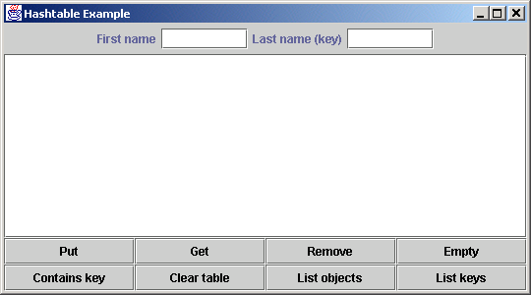
Fig. 20.3 Demonstrating class Hashtable (Part 9).
Program Output

Slide 30
20.6 Properties Class
Properties
  Persistent Hashtable
    Can be written to output stream and directed to file
    Can be read from file into input stream
  Provides methods setProperty and getProperty
    Store/obtain key-value pairs of Strings

Slide 31
Fig. 20.4 Demonstrating class Properties.
Line 25
1 // Fig. 20.4: PropertiesTest.java
2 // Demonstrates class Properties of the java.util package.
3
4 // Java core packages
5 import java.awt.*;
6 import java.awt.event.*;
7 import java.io.*;
8 import java.util.*;
9
10 // Java extension packages
11 import javax.swing.*;
12
13 public class PropertiesTest extends JFrame {
14 private JLabel statusLabel;
15 private Properties table;
16 private JTextArea displayArea;
17 private JTextField valueField, nameField;
18
19 // set up GUI to test Properties table
20 public PropertiesTest()
21 {
22 super( "Properties Test" );
23
24 // create Properties table
25 table = new Properties();
26
27 Container container = getContentPane();
28
29 // set up NORTH of window's BorderLayout
30 JPanel northSubPanel = new JPanel();
31
32 northSubPanel.add( new JLabel( "Property value" ) );
33 valueField = new JTextField( 10 );
34 northSubPanel.add( valueField );
35
Create empty Properties

Slide 32
Fig. 20.4 Demonstrating class Properties (Part 2).
Lines 68-69
36 northSubPanel.add( new JLabel( "Property name (key)" ) );
37 nameField = new JTextField( 10 );
38 northSubPanel.add( nameField );
39
40 JPanel northPanel = new JPanel();
41 northPanel.setLayout( new BorderLayout() );
42 northPanel.add( northSubPanel, BorderLayout.NORTH );
43
44 statusLabel = new JLabel();
45 northPanel.add( statusLabel, BorderLayout.SOUTH );
46
47 container.add( northPanel, BorderLayout.NORTH );
48
49 // set up CENTER of window's BorderLayout
50 displayArea = new JTextArea( 4, 35 );
51 container.add( new JScrollPane( displayArea ),
52 BorderLayout.CENTER );
53
54 // set up SOUTH of window's BorderLayout
55 JPanel southPanel = new JPanel();
56 southPanel.setLayout( new GridLayout( 1, 5 ) );
57
58 // button to put a name/value pair in Properties table
59 JButton putButton = new JButton( "Put" );
60
61 putButton.addActionListener(
62
63 new ActionListener() {
64
65 // put name/value pair in Properties table
66 public void actionPerformed( ActionEvent event )
67 {
68 Object value = table.setProperty(
69 nameField.getText(), valueField.getText() );
70
Properties method setProperty stores value for the specified key

Slide 33
Fig. 20.4 Demonstrating class Properties (Part 3).
71 if ( value == null )
72 showstatus( "Put: " + nameField.getText() +
73 " " + valueField.getText() );
74
75 else
76 showstatus( "Put: " + nameField.getText() +
77 " " + valueField.getText() +
78 "; Replaced: " + value.toString() );
79
80 listProperties();
81 }
82 }
83 ); // end call to addActionListener
84
85 southPanel.add( putButton );
86
87 // button to empty contents of Properties table
88 JButton clearButton = new JButton( "Clear" );
89
90 clearButton.addActionListener(
91
92 new ActionListener() {
93
94 // use method clear to empty table
95 public void actionPerformed( ActionEvent event )
96 {
97 table.clear();
98 showstatus( "Table in memory cleared" );
99 listProperties();
100 }
101 }
102 ); // end call to addActionListener
103
104 southPanel.add( clearButton );
105

Slide 34
Fig. 20.4 Demonstrating class Properties (Part 4).
Lines 116-117
106 // button to get value of a property
107 JButton getPropertyButton = new JButton( "Get property" );
108
109 getPropertyButton.addActionListener(
110
111 new ActionListener() {
112
113 // use method getProperty to obtain a property value
114 public void actionPerformed( ActionEvent event )
115 {
116 Object value = table.getProperty(
117 nameField.getText() );
118
119 if ( value != null )
120 showstatus( "Get property: " +
121 nameField.getText() + " " +
122 value.toString() );
123
124 else
125 showstatus( "Get: " + nameField.getText() +
126 " not in table" );
127
128 listProperties();
129 }
130 }
131 ); // end call to addActionListener
132
133 southPanel.add( getPropertyButton );
134
135 // button to contents of Properties table to file
136 JButton saveButton = new JButton( "Save" );
137
138 saveButton.addActionListener(
139
Properties method getProperty locates value associated with the specified key

Slide 35
Fig. 20.4 Demonstrating class Properties (Part 5).
Line 150
140 new ActionListener() {
141
142 // use method save to place contents in file
143 public void actionPerformed( ActionEvent event )
144 {
145 // save contents of table
146 try {
147 FileOutputStream output =
148 new FileOutputStream( "props.dat" );
149
150 table.store( output, "Sample Properties" );
151 output.close();
152
153 listProperties();
154 }
155
156 // process problems with file output
157 catch( IOException ioException ) {
158 ioException.printStackTrace();
159 }
160 }
161 }
162 ); // end call to addActionListener
163
164 southPanel.add( saveButton );
165
166 // button to load contents of Properties table from file
167 JButton loadButton = new JButton( "Load" );
168
169 loadButton.addActionListener(
170
171 new ActionListener() {
172
Properties method store saves Properties contents to FileOutputStream

Slide 36
Fig. 20.4 Demonstrating class Properties (Part 6).
Line 181
173 // use method load to read contents from file
174 public void actionPerformed( ActionEvent event )
175 {
176 // load contents of table
177 try {
178 FileInputStream input =
179 new FileInputStream( "props.dat" );
180
181 table.load( input );
182 input.close();
183 listProperties();
184 }
185
186 // process problems with file input
187 catch( IOException ioException ) {
188 ioException.printStackTrace();
189 }
190 }
191 }
192 ); // end call to addActionListener
193
194 southPanel.add( loadButton );
195
196 container.add( southPanel, BorderLayout.SOUTH );
197
198 setSize( 550, 225 );
199 setVisible( true );
200 }
201
202 // output property values
203 public void listProperties()
204 {
205 StringBuffer buffer = new StringBuffer();
206 String name, value;
207
Properties method load restores Properties contents from FileInputStream

Slide 37
Fig. 20.4 Demonstrating class Properties (Part 7).
Line 208
208 Enumeration enumeration = table.propertyNames();
209
210 while ( enumeration.hasMoreElements() ) {
211 name = enumeration.nextElement().toString();
212 value = table.getProperty( name );
213
214 buffer.append( name ).append( '\t' );
215 buffer.append( value ).append( '\n' );
216 }
217
218 displayArea.setText( buffer.toString() );
219 } // end method ListProperties
220
221 // display String in statusLabel label
222 public void showstatus( String s )
223 {
224 statusLabel.setText( s );
225 }
226
227 // execute application
228 public static void main( String args[] )
229 {
230 PropertiesTest application = new PropertiesTest();
231
232 application.setDefaultCloseOperation(
233 JFrame.EXIT_ON_CLOSE );
234 }
235
236 } // end class PropertiesTest
Properties method propertyNames obtains Enumeration of property names

Slide 38
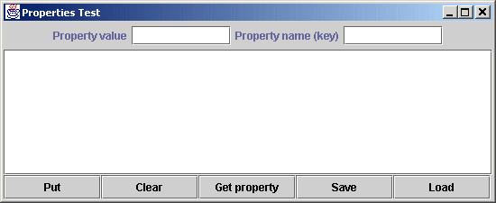
Fig. 20.4 Demonstrating class Properties (Part 8).
Program Output

Slide 39
20.7 Random Class
Class Random
  Provides (pseudo-) random-number generation
    Random r = new Random();
  Use seed to generate same random-number sequences
    Random r = new Random( seedValue );
    (useful when debugging)
  Can generate distributed numbers uniformly
    r.nextInt();
    r.nextFloat();
  Use % operator to scale generated number
    e.g., rolling a six-sided die
  Math.abs( r.nextInt() ) % 6 + 1;

Slide 40
20.8 Bit Manipulation and the Bitwise Operators
Bitwise operators
  Used for bit manipulation
  Used for getting down to “bit-and-bytes” level

Slide 41
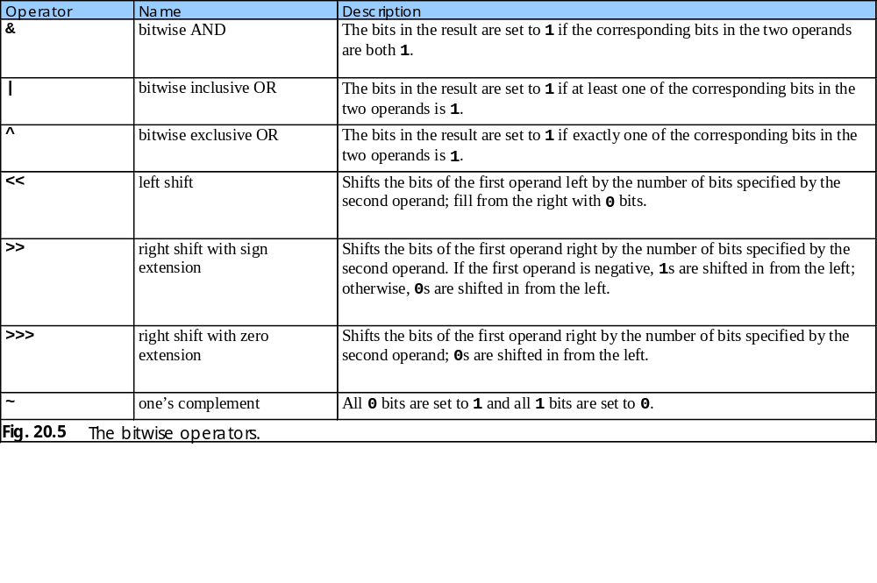
20.8 Bit Manipulation and the Bitwise Operators (cont.)

Slide 42
Fig. 20.6 Printing the bits in an integer.
1 // Fig. 20.6: PrintBits.java
2 // Printing an unsigned integer in bits
3
4 // Java core packages
5 import java.awt.*;
6 import java.awt.event.*;
7
8 // Java extension packages
9 import javax.swing.*;
10
11 public class PrintBits extends JFrame {
12 private JTextField outputField;
13
14 // set up GUI
15 public PrintBits()
16 {
17 super( "Printing bit representations for numbers" );
18
19 Container container = getContentPane();
20 container.setLayout( new FlowLayout() );
21
22 container.add( new JLabel( "Enter an integer " ) );
23
24 // textfield to read value from user
25 JTextField inputField = new JTextField( 10 );
26
27 inputField.addActionListener(
28
29 new ActionListener() {
30

Slide 43
Fig. 20.6 Printing the bits in an integer (Part 2).
Lines 34-35
Line 58
31 // read integer and get bitwise representation
32 public void actionPerformed( ActionEvent event )
33 {
34 int value = Integer.parseInt(
35 event.getActionCommand() );
36 outputField.setText( getBits( value ) );
37 }
38 }
39 );
40
41 container.add( inputField );
42
43 container.add( new JLabel( "The integer in bits is" ) );
44
45 // textfield to display integer in bitwise form
46 outputField = new JTextField( 33 );
47 outputField.setEditable( false );
48 container.add( outputField );
49
50 setSize( 720, 70 );
51 setVisible( true );
52 }
53
54 // display bit representation of specified int value
55 private String getBits( int value )
56 {
57 // create int value with 1 in leftmost bit and 0s elsewhere
58 int displayMask = 1 << 31;
59
60 // buffer to build output
61 StringBuffer buffer = new StringBuffer( 35 );
62
63 // for each bit append 0 or 1 to buffer
64 for ( int bit = 1; bit <= 32; bit++ ) {
65
Convert String to int, then pass int to private method getBits to get the int’s bit representation
1 << 31 equals 10000000 00000000 00000000 00000000

Slide 44
Fig. 20.6 Printing the bits in an integer (Part 3).
Line 69
66 // use displayMask to isolate bit and determine whether
67 // bit has value of 0 or 1
68 buffer.append(
69 ( value & displayMask ) == 0 ? '0' : '1' );
70
71 // shift value one position to left
72 value <<= 1;
73
74 // append space to buffer every 8 bits
75 if ( bit % 8 == 0 )
76 buffer.append( ' ' );
77 }
78
79 return buffer.toString();
80 }
81
82 // execute application
83 public static void main( String args[] )
84 {
85 PrintBits application = new PrintBits();
86
87 application.setDefaultCloseOperation(
88 JFrame.EXIT_ON_CLOSE );
89 }
90
91 } // end class PrintBits
Use bitwise AND (&) to combine each bit in value and 1 << 31

Slide 45
Fig. 20.6 Printing the bits in an integer (Part 4).
Program Output

Slide 46
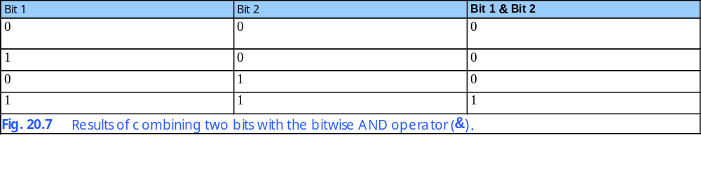
20.8 Bit manipulation and the Bitwise Operators (cont.)

Slide 47
Fig. 20.8 Demonstrating the bitwise AND, bitwise inclusive OR, bitwise exclusive OR and bitwise complement operators.
1 // Fig. 20.8: MiscBitOps.java
2 // Using the bitwise AND, bitwise inclusive OR, bitwise
3 // exclusive OR, and bitwise complement operators.
4
5 // Java core packages
6 import java.awt.*;
7 import java.awt.event.*;
8
9 // Java extension packages
10 import javax.swing.*;
11
12 public class MiscBitOps extends JFrame {
13 private JTextField input1Field, input2Field,
14 bits1Field, bits2Field, bits3Field, resultField;
15 private int value1, value2;
16
17 // set up GUI
18 public MiscBitOps()
19 {
20 super( "Bitwise operators" );
21
22 JPanel inputPanel = new JPanel();
23 inputPanel.setLayout( new GridLayout( 4, 2 ) );
24
25 inputPanel.add( new JLabel( "Enter 2 ints" ) );
26 inputPanel.add( new JLabel( "" ) );
27
28 inputPanel.add( new JLabel( "Value 1" ) );
29 input1Field = new JTextField( 8 );
30 inputPanel.add( input1Field );
31
32 inputPanel.add( new JLabel( "Value 2" ) );
33 input2Field = new JTextField( 8 );
34 inputPanel.add( input2Field );
35

Slide 48
Fig. 20.8 Demonstrating the bitwise AND, bitwise inclusive OR, bitwise exclusive OR and bitwise complement operators (Part 2).
36 inputPanel.add( new JLabel( "Result" ) );
37 resultField = new JTextField( 8 );
38 resultField.setEditable( false );
39 inputPanel.add( resultField );
40
41 JPanel bitsPanel = new JPanel();
42 bitsPanel.setLayout( new GridLayout( 4, 1 ) );
43 bitsPanel.add( new JLabel( "Bit representations" ) );
44
45 bits1Field = new JTextField( 33 );
46 bits1Field.setEditable( false );
47 bitsPanel.add( bits1Field );
48
49 bits2Field = new JTextField( 33 );
50 bits2Field.setEditable( false );
51 bitsPanel.add( bits2Field );
52
53 bits3Field = new JTextField( 33 );
54 bits3Field.setEditable( false );
55 bitsPanel.add( bits3Field );
56
57 JPanel buttonPanel = new JPanel();
58
59 // button to perform bitwise AND
60 JButton andButton = new JButton( "AND" );
61
62 andButton.addActionListener(
63
64 new ActionListener() {
65

Slide 49
Fig. 20.8 Demonstrating the bitwise AND, bitwise inclusive OR, bitwise exclusive OR and bitwise complement operators (Part 3).
Line 71
Line 91
66 // perform bitwise AND and display results
67 public void actionPerformed( ActionEvent event )
68 {
69 setFields();
70 resultField.setText(
71 Integer.toString( value1 & value2 ) );
72 bits3Field.setText( getBits( value1 & value2 ) );
73 }
74 }
75 );
76
77 buttonPanel.add( andButton );
78
79 // button to perform bitwise inclusive OR
80 JButton inclusiveOrButton = new JButton( "Inclusive OR" );
81
82 inclusiveOrButton.addActionListener(
83
84 new ActionListener() {
85
86 // perform bitwise inclusive OR and display results
87 public void actionPerformed( ActionEvent event )
88 {
89 setFields();
90 resultField.setText(
91 Integer.toString( value1 | value2 ) );
92 bits3Field.setText( getBits( value1 | value2 ) );
93 }
94 }
95 );
96
97 buttonPanel.add( inclusiveOrButton );
98
Use bitwise AND (&) to combine value1 and value2
Use bitwise inclusive OR (|) to combine value1 and value2

Slide 50
Fig. 20.8 Demonstrating the bitwise AND, bitwise inclusive OR, bitwise exclusive OR and bitwise complement operators (Part 4).
Line 111
99 // button to perform bitwise exclusive OR
100 JButton exclusiveOrButton = new JButton( "Exclusive OR" );
101
102 exclusiveOrButton.addActionListener(
103
104 new ActionListener() {
105
106 // perform bitwise exclusive OR and display results
107 public void actionPerformed( ActionEvent event )
108 {
109 setFields();
110 resultField.setText(
111 Integer.toString( value1 ^ value2 ) );
112 bits3Field.setText( getBits( value1 ^ value2 ) );
113 }
114 }
115 );
116
117 buttonPanel.add( exclusiveOrButton );
118
119 // button to perform bitwise complement
120 JButton complementButton = new JButton( "Complement" );
121
122 complementButton.addActionListener(
123
124 new ActionListener() {
125
126 // perform bitwise complement and display results
127 public void actionPerformed( ActionEvent event )
128 {
129 input2Field.setText( "" );
130 bits2Field.setText( "" );
131
132 int value = Integer.parseInt( input1Field.getText() );
133
Use bitwise exclusive OR (^) to combine value1 and value2

Slide 51
Fig. 20.8 Demonstrating the bitwise AND, bitwise inclusive OR, bitwise exclusive OR and bitwise complement operators (Part 5).
Line 134
134 resultField.setText( Integer.toString( ~value ) );
135 bits1Field.setText( getBits( value ) );
136 bits3Field.setText( getBits( ~value ) );
137 }
138 }
139 );
140
141 buttonPanel.add( complementButton );
142
143 Container container = getContentPane();
144 container.add( inputPanel, BorderLayout.WEST );
145 container.add( bitsPanel, BorderLayout.EAST );
146 container.add( buttonPanel, BorderLayout.SOUTH );
147
148 setSize( 600, 150 );
149 setVisible( true );
150 }
151
152 // display numbers and their bit form
153 private void setFields()
154 {
155 value1 = Integer.parseInt( input1Field.getText() );
156 value2 = Integer.parseInt( input2Field.getText() );
157
158 bits1Field.setText( getBits( value1 ) );
159 bits2Field.setText( getBits( value2 ) );
160 }
161
162 // display bit representation of specified int value
163 private String getBits( int value )
164 {
165 // create int value with 1 in leftmost bit and 0s elsewhere
166 int displayMask = 1 << 31;
167
Use bitwise complement (~) on value

Slide 52
Fig. 20.8 Demonstrating the bitwise AND, bitwise inclusive OR, bitwise exclusive OR and bitwise complement operators (Part 6).
168 // buffer to build output
169 StringBuffer buffer = new StringBuffer( 35 );
170
171 // for each bit append 0 or 1 to buffer
172 for ( int bit = 1; bit <= 32; bit++ ) {
173
174 // use displayMask to isolate bit and determine whether
175 // bit has value of 0 or 1
176 buffer.append(
177 ( value & displayMask ) == 0 ? '0' : '1' );
178
179 // shift value one position to left
180 value <<= 1;
181
182 // append space to buffer every 8 bits
183 if ( bit % 8 == 0 )
184 buffer.append( ' ' );
185 }
186
187 return buffer.toString();
188 }
189
190 // execute application
191 public static void main( String args[] )
192 {
193 MiscBitOps application = new MiscBitOps();
194
195 application.setDefaultCloseOperation(
196 JFrame.EXIT_ON_CLOSE );
197 }
198
199 } // end class MiscBitOps

Slide 53
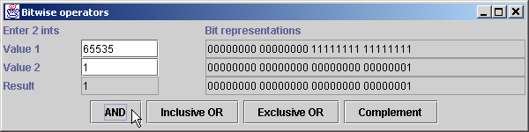
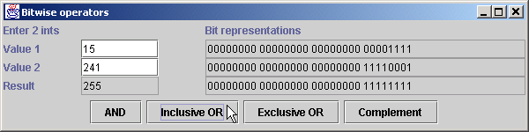
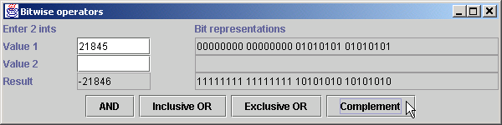
Fig. 20.8 Demonstrating the bitwise AND, bitwise inclusive OR, bitwise exclusive OR and bitwise complement operators (Part 7).
Program Output

Slide 54
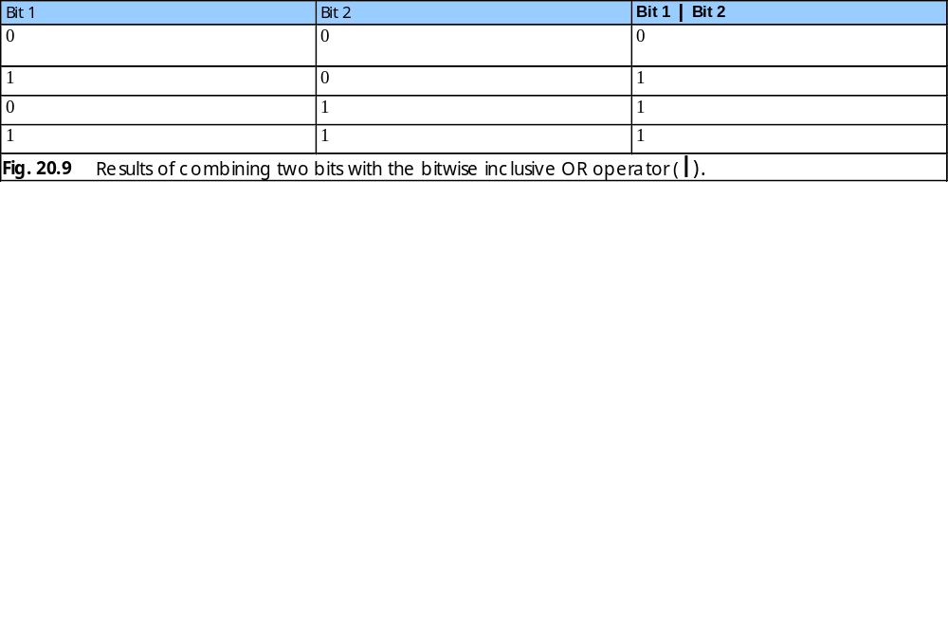
20.8 Bit Manipulation and the Bitwise Operators (cont.)

Slide 55

20.8 Bit Manipulation and the Bitwise Operators (cont.)

Slide 56
Fig. 20.11 Demonstrating the bitwise shift operators.
1 // Fig. 20.11: BitShift.java
2 // Using the bitwise shift operators.
3
4 // Java core packages
5 import java.awt.*;
6 import java.awt.event.*;
7
8 // Java extension packages
9 import javax.swing.*;
10
11 public class BitShift extends JFrame {
12 private JTextField bitsField;
13 private JTextField valueField;
14
15 // set up GUI
16 public BitShift()
17 {
18 super( "Shifting bits" );
19
20 Container container = getContentPane();
21 container.setLayout( new FlowLayout() );
22
23 container.add( new JLabel( "Integer to shift " ) );
24
25 // textfield for user to input integer
26 valueField = new JTextField( 12 );
27 container.add( valueField );
28
29 valueField.addActionListener(
30
31 new ActionListener() {
32

Slide 57
Fig. 20.11 Demonstrating the bitwise shift operators (Part 2).
Line 58
33 // read value and display its bitwise representation
34 public void actionPerformed( ActionEvent event )
35 {
36 int value = Integer.parseInt( valueField.getText() );
37 bitsField.setText( getBits( value ) );
38 }
39 }
40 );
41
42 // textfield to display bitwise representation of an integer
43 bitsField = new JTextField( 33 );
44 bitsField.setEditable( false );
45 container.add( bitsField );
46
47 // button to shift bits left by one position
48 JButton leftButton = new JButton( "<<" );
49
50 leftButton.addActionListener(
51
52 new ActionListener() {
53
54 // left shift one position and display new value
55 public void actionPerformed( ActionEvent event )
56 {
57 int value = Integer.parseInt( valueField.getText() );
58 value <<= 1;
59 valueField.setText( Integer.toString( value ) );
60 bitsField.setText( getBits( value ) );
61 }
62 }
63 );
64
65 container.add( leftButton );
66
Use bitwise left-shift operator (<<) to shift value’s bits to the left by one position

Slide 58
Fig. 20.11 Demonstrating the bitwise shift operators (Part 3).
Line 78
Line 98
67 // button to right shift value one position with sign extension
68 JButton rightSignButton = new JButton( ">>" );
69
70 rightSignButton.addActionListener(
71
72 new ActionListener() {
73
74 // right shift one position and display new value
75 public void actionPerformed( ActionEvent event )
76 {
77 int value = Integer.parseInt( valueField.getText() );
78 value >>= 1;
79 valueField.setText( Integer.toString( value ) );
80 bitsField.setText( getBits( value ) );
81 }
82 }
83 );
84
85 container.add( rightSignButton );
86
87 // button to right shift value one position with zero extension
88 JButton rightZeroButton = new JButton( ">>>" );
89
90 rightZeroButton.addActionListener(
91
92 new ActionListener() {
93
94 // right shift one position and display new value
95 public void actionPerformed( ActionEvent event )
96 {
97 int value = Integer.parseInt( valueField.getText() );
98 value >>>= 1;
99 valueField.setText( Integer.toString( value ) );
100
101 bitsField.setText( getBits( value ) );
Use bitwise right-shift with signed extension operator (>>) to shift value’s bits to the right by one position
Use bitwise right-shift with unsigned extension operator (>>>) to shift value’s bits to the right by one position

Slide 59
Fig. 20.11 Demonstrating the bitwise shift operators (Part 4).
102 }
103 }
104 );
105
106 container.add( rightZeroButton );
107
108 setSize( 400, 120 );
109 setVisible( true );
110 }
111
112 // display bit representation of specified int value
113 private String getBits( int value )
114 {
115 // create int value with 1 in leftmost bit and 0s elsewhere
116 int displayMask = 1 << 31;
117
118 // buffer to build output
119 StringBuffer buffer = new StringBuffer( 35 );
120
121 // for each bit append 0 or 1 to buffer
122 for ( int bit = 1; bit <= 32; bit++ ) {
123
124 // use displayMask to isolate bit and determine whether
125 // bit has value of 0 or 1
126 buffer.append(
127 ( value & displayMask ) == 0 ? '0' : '1' );
128
129 // shift value one position to left
130 value <<= 1;
131
132 // append space to buffer every 8 bits
133 if ( bit % 8 == 0 )
134 buffer.append( ' ' );
135 }
136

Slide 60
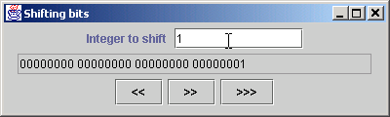
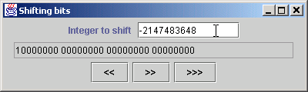
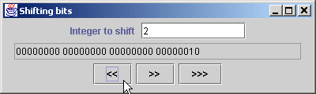
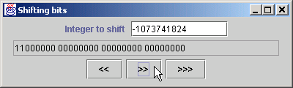
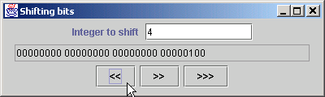
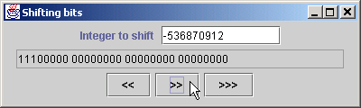
Fig. 20.11 Demonstrating the bitwise shift operators (Part 5).
Program Output
137 return buffer.toString();
138 }
139
140 // execute application
141 public static void main( String args[] )
142 {
143 BitShift application = new BitShift();
144
145 application.setDefaultCloseOperation(
146 JFrame.EXIT_ON_CLOSE );
147 }
148
149 } // end class BitShift

Slide 61
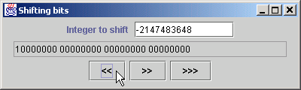
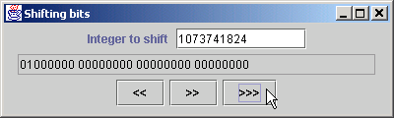
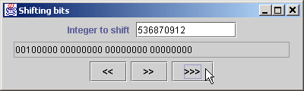
Fig. 20.11 Demonstrating the bitwise shift operators (Part 6).
Program Output

Slide 62
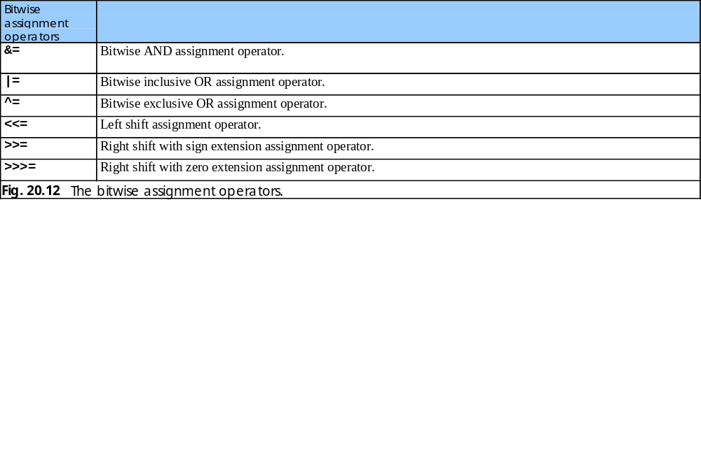
20.8 Bit Manipulation and the Bitwise Operator (cont.)

Slide 63
20.9 BitSet class
BitSet
  Facilitates the creation and manipulation of bit sets
  Represent set of boolean flags
  Dynamically resizable

Slide 64
Fig. 20.13 Demonstrating the Sieve of Eratosthenes using a BitSet.
Line 22
1 // Fig. 20.13: BitSetTest.java
2 // Using a BitSet to demonstrate the Sieve of Eratosthenes.
3
4 // Java core packages
5 import java.awt.*;
6 import java.awt.event.*;
7 import java.util.*;
8
9 // Java extension packages
10 import javax.swing.*;
11
12 public class BitSetTest extends JFrame {
13 private BitSet sieve;
14 private JLabel statusLabel;
15 private JTextField inputField;
16
17 // set up GUI
18 public BitSetTest()
19 {
20 super( "BitSets" );
21
22 sieve = new BitSet( 1024 );
23
24 Container container = getContentPane();
25
26 statusLabel = new JLabel( "" );
27 container.add( statusLabel, BorderLayout.SOUTH );
28
29 JPanel inputPanel = new JPanel();
30
31 inputPanel.add( new JLabel(
32 "Enter a value from 2 to 1023" ) );
33
34 // textfield for user to input a value from 2 to 1023
35 inputField = new JTextField( 10 );
Create bitset of 1024 bits

Slide 65
Fig. 20.13 Demonstrating the Sieve of Eratosthenes using a BitSet (Part 2).
Lines 68-69
36
37 inputField.addActionListener(
38
39 new ActionListener() {
40
41 // determine whether value is prime number
42 public void actionPerformed( ActionEvent event )
43 {
44 int value = Integer.parseInt( inputField.getText() );
45
46 if ( sieve.get( value ) )
47 statusLabel.setText(
48 value + " is a prime number" );
49
50 else
51 statusLabel.setText( value +
52 " is not a prime number" );
53 }
54 }
55 );
56
57 inputPanel.add( inputField );
58 container.add( inputPanel, BorderLayout.NORTH );
59
60 JTextArea primesArea = new JTextArea();
61
62 container.add( new JScrollPane( primesArea ),
63 BorderLayout.CENTER );
64
65 // set all bits from 1 to 1023
66 int size = sieve.size();
67
68 for ( int i = 2; i < size; i++ )
69 sieve.set( i );
70
Use method set to turn on all bits in BitSet

Slide 66
Fig. 20.13 Demonstrating the Sieve of Eratosthenes using a BitSet (Part 3).
Lines 72-79
71 // perform Sieve of Eratosthenes
72 int finalBit = ( int ) Math.sqrt( sieve.size() );
73
74 for ( int i = 2; i < finalBit; i++ )
75
76 if ( sieve.get( i ) )
77
78 for ( int j = 2 * i; j < size; j += i )
79 sieve.clear( j );
80
81 // display prime numbers from 1 to 1023
82 int counter = 0;
83
84 for ( int i = 2; i < size; i++ )
85
86 if ( sieve.get( i ) ) {
87 primesArea.append( String.valueOf( i ) );
88 primesArea.append( ++counter % 7 == 0 ? "\n" : "\t" );
89 }
90
91 setSize( 600, 450 );
92 setVisible( true );
93 }
94
95 // execute application
96 public static void main( String args[] )
97 {
98 BitSetTest application = new BitSetTest();
99
100 application.setDefaultCloseOperation(
101 JFrame.EXIT_ON_CLOSE );
102 }
103
104 } // end class BitSetTest
Determine prime numbers

Slide 67
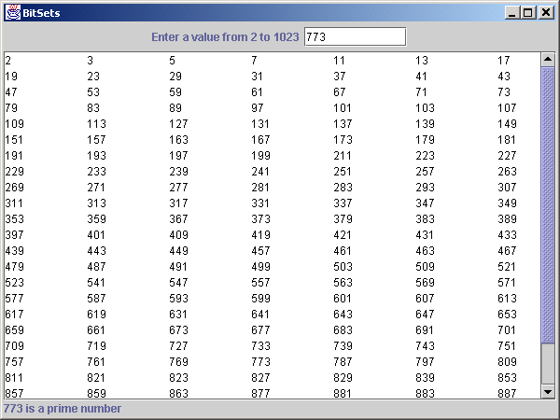
Fig. 20.13 Demonstrating the Sieve of Eratosthenes using a BitSet (Part 4).
Program Output

